Slide 1
Listening and integrated skills A2
Instructor: Nguyen Ha Phuong

Slide 2
Unit 4: Wild weather
Pages 61-80

Slide 3
Lesson objectives
By the end of the lesson, students will be able to:
respond to a listening and video about strange and dangerous weather events.
respond to a listening about sports and climate change.
listen for definition.
use synonyms.
abbreviate numbers and measurements.

Slide 4
TABLE OF CONTENTS
01
02
03
04
05
VOCABULARY A
LISTENING A
VIDEO WATCHING
VOCABULARY B
LISTENING B

Slide 5
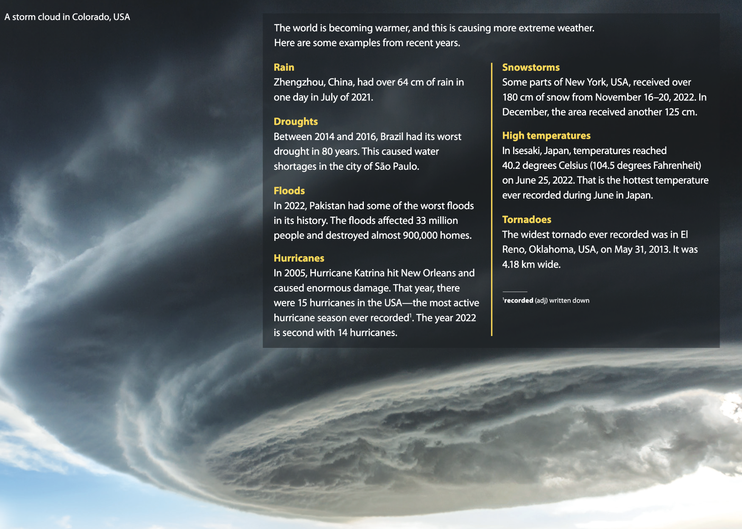
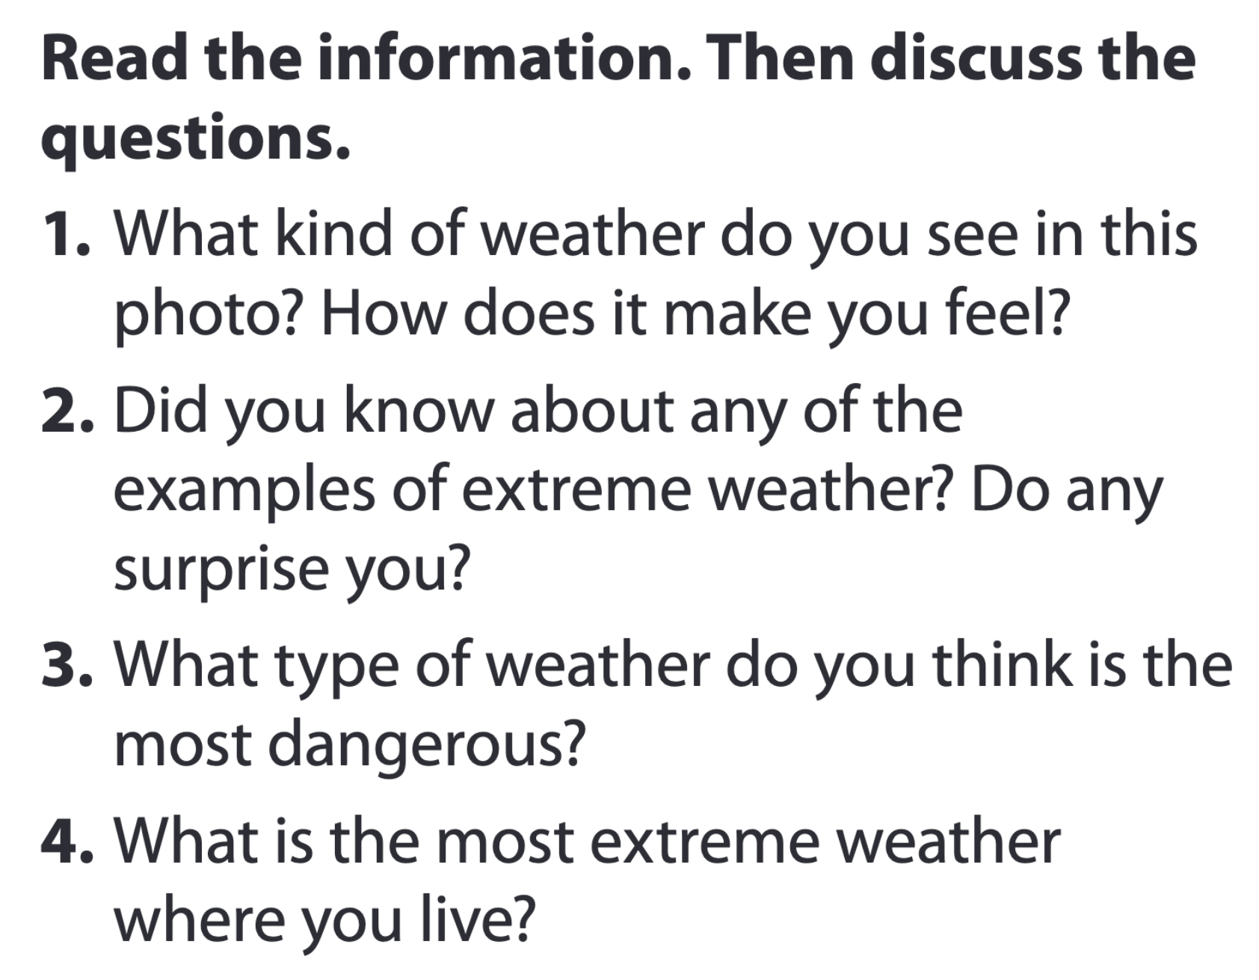
Extreme weather around the word

Slide 6

01
Vocabulary A

Slide 7

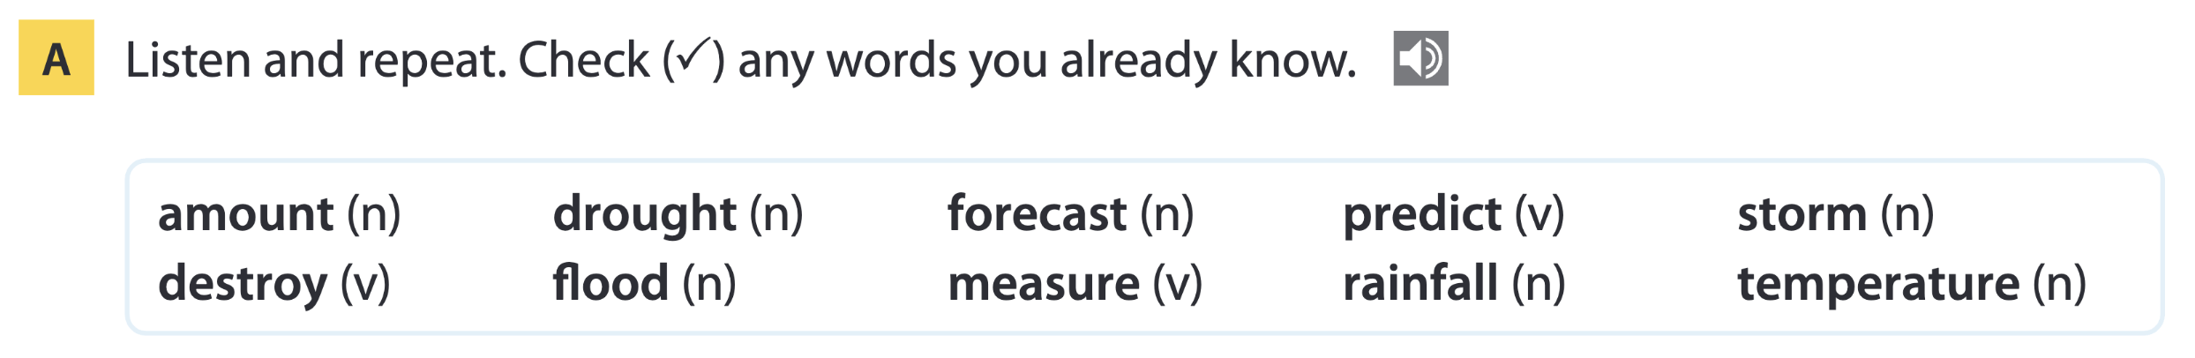
Page 64

Slide 8
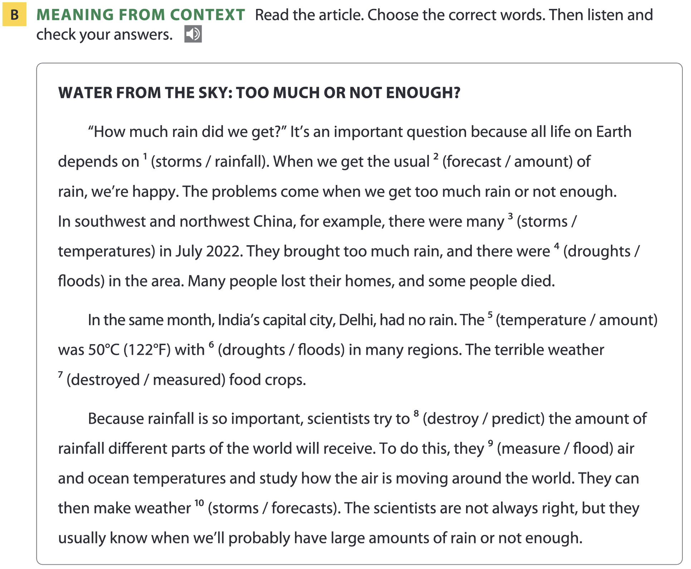
Page 64

Slide 9
Word list
amount /əˈmaʊnt/ (n): lượng
destroy /dɪˈstrɔɪ/ (v): phá hủy
drought /draʊt/ (n): hạn hán
flood /flʌd/ (n): lũ lụt
forecast /ˈfɔːkɑːst/ (n): dự báo
measure /ˈmeʒə(r)/ (v): đo lường
predict /prɪˈdɪkt/ (v): dự đoán
rainfall /ˈreɪnfɔːl/ (n): lượng mưa
storm /stɔːm/ (n): cơn bão
temperature /ˈtemprətʃə(r)/ (n): nhiệt độ

Slide 10
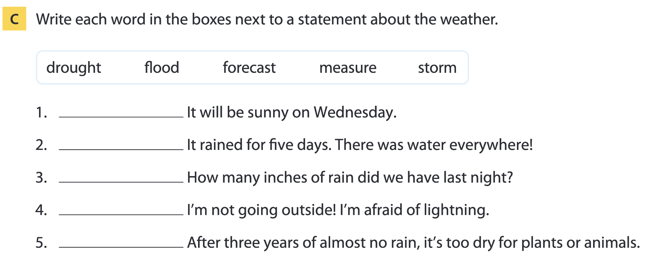
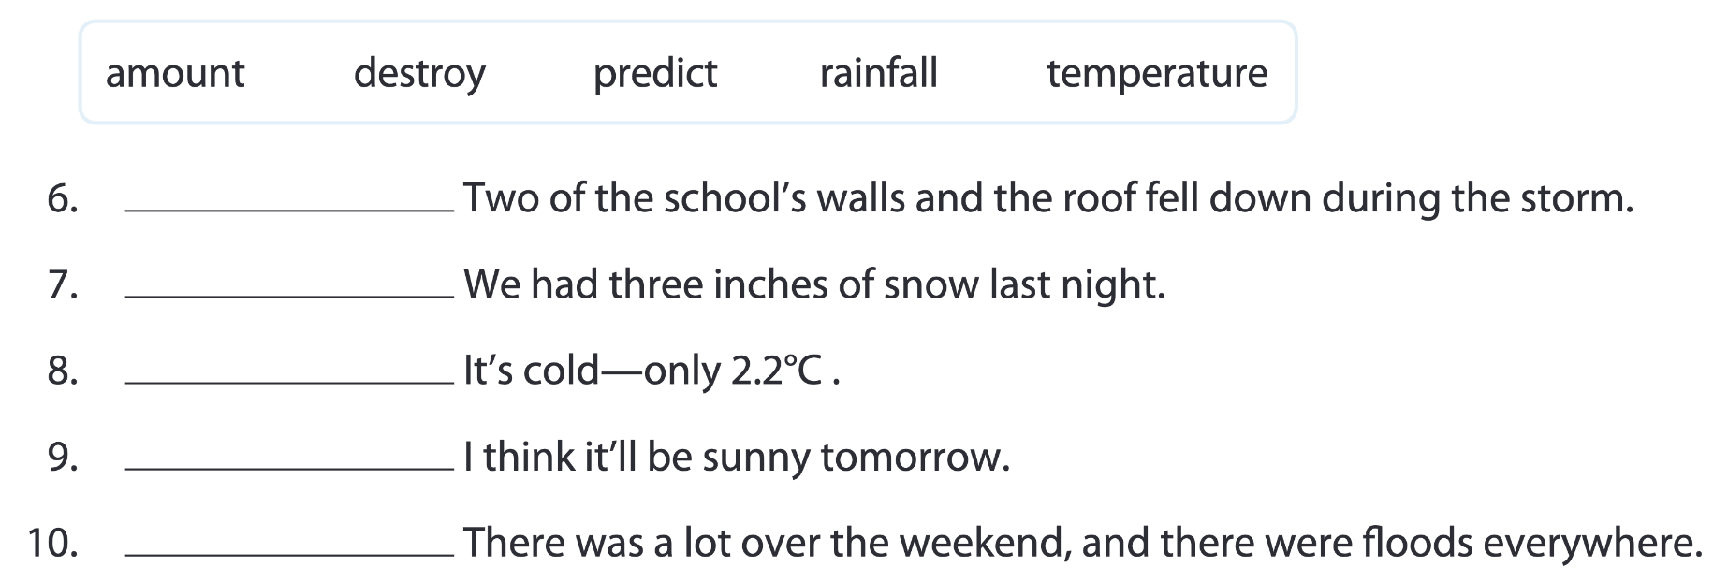
Pages 64-65
forecast
flood
measure
storm
drought
destroy
amount
temperature
predict
rainfall

Slide 11
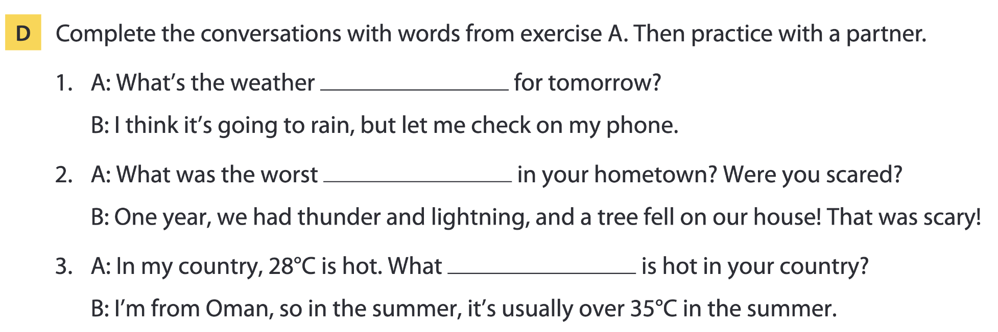
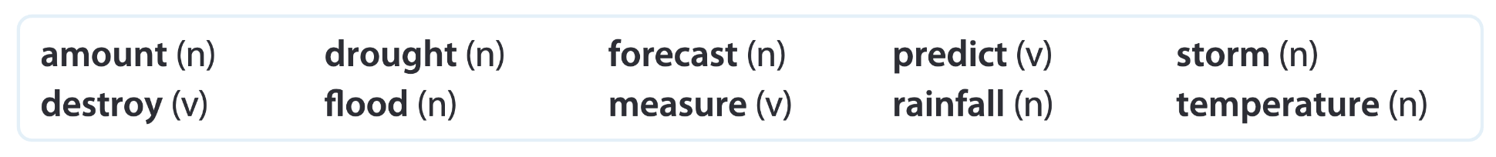
Page 65
forecast
storm
temperature

Slide 12
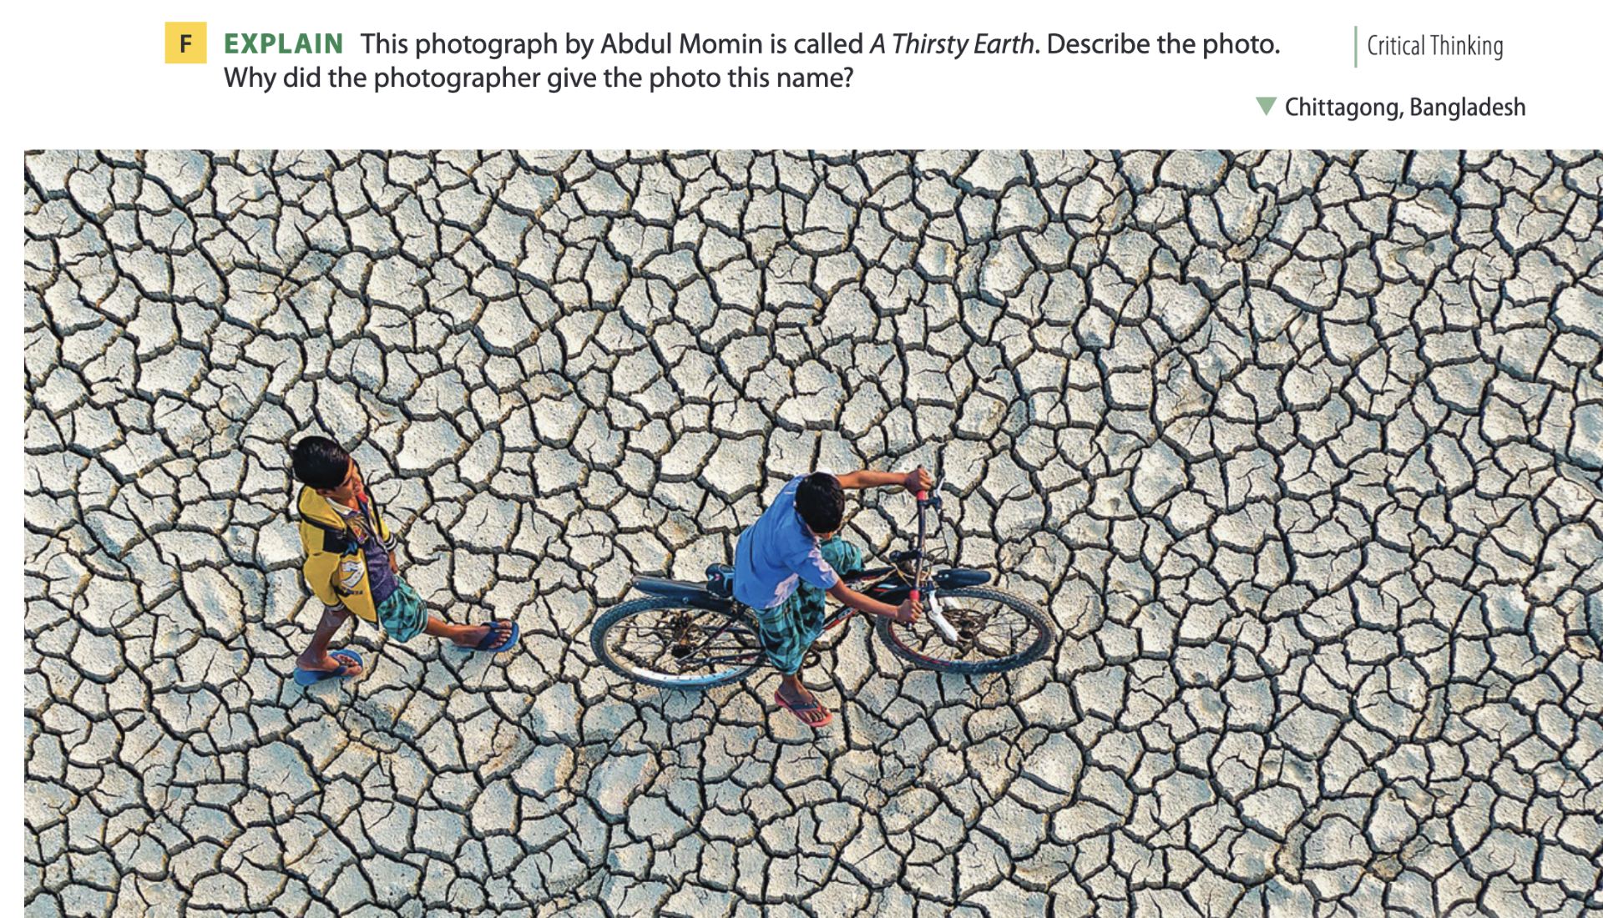
Page 65

Slide 13

02
Listening A

Slide 14
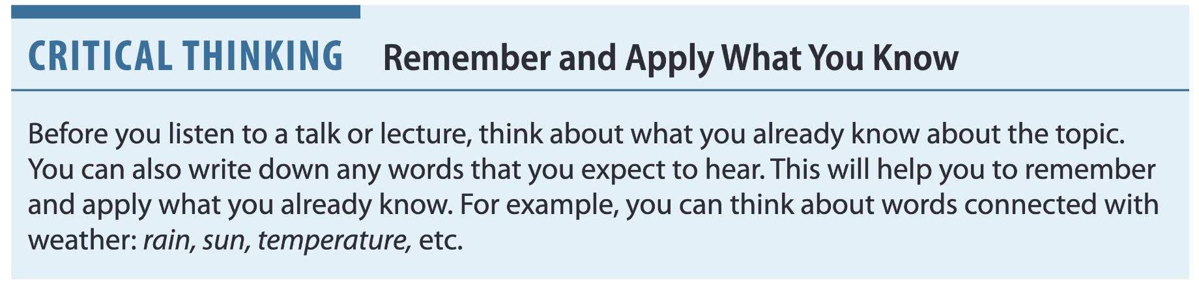
Strange weather
Page 66

Slide 15
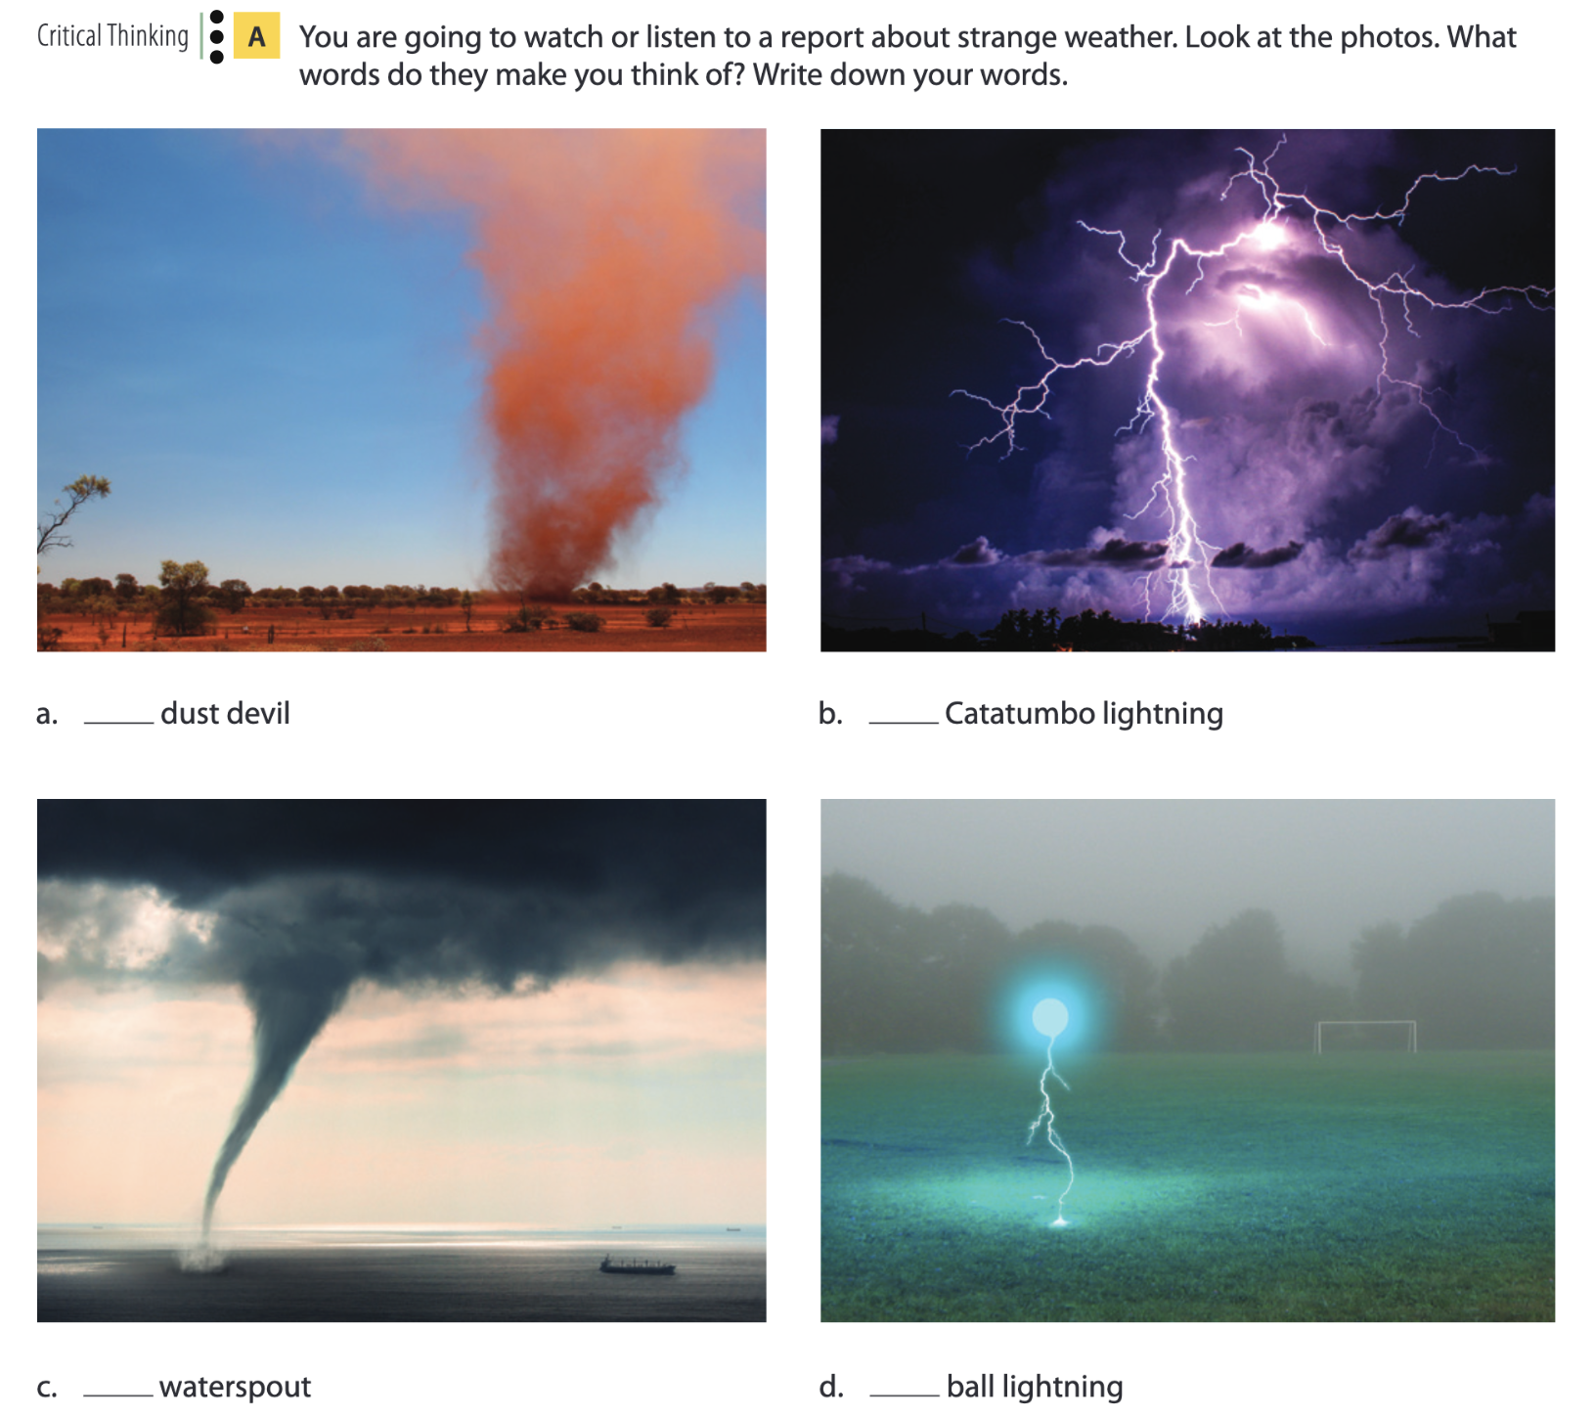
Page 66

Slide 16
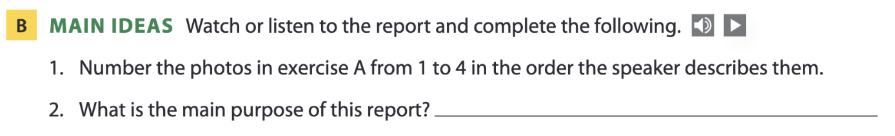
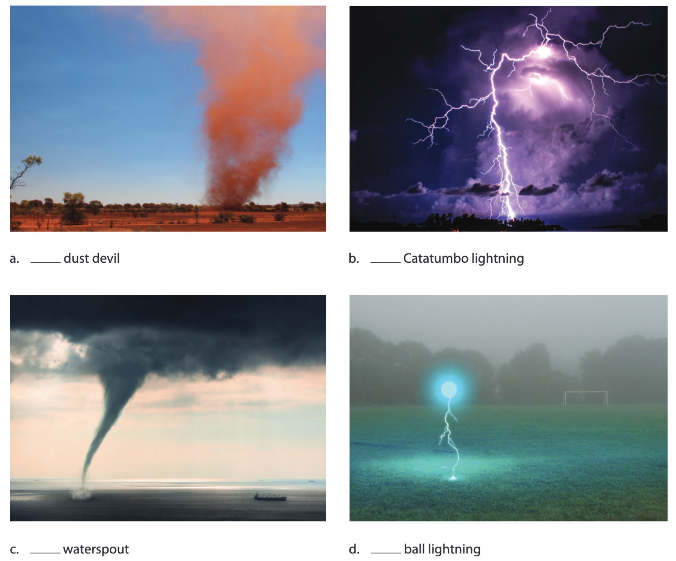
Page 67
To describe strange weather, such as ball lightning, dust devils, and waterspouts.
3
1
4
2

Slide 17
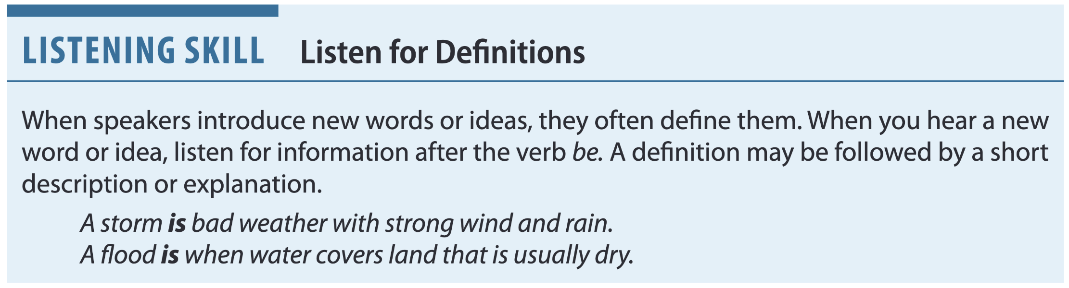
Page 67

Slide 18
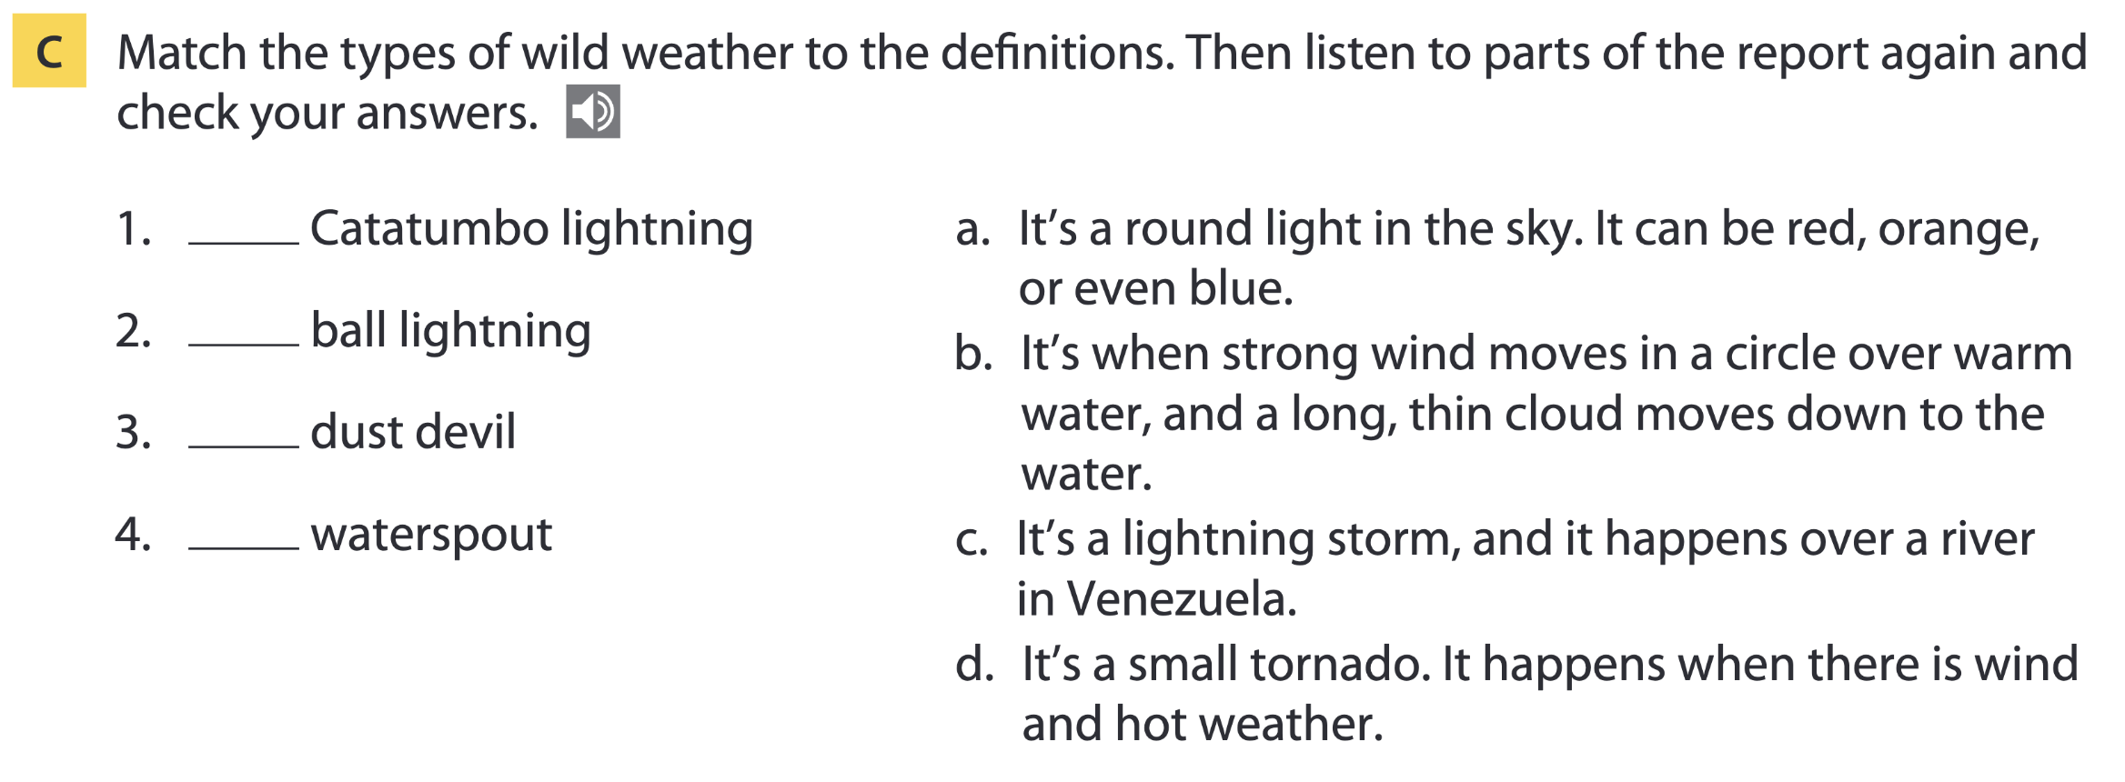
Page 67
c
a
d
b

Slide 19
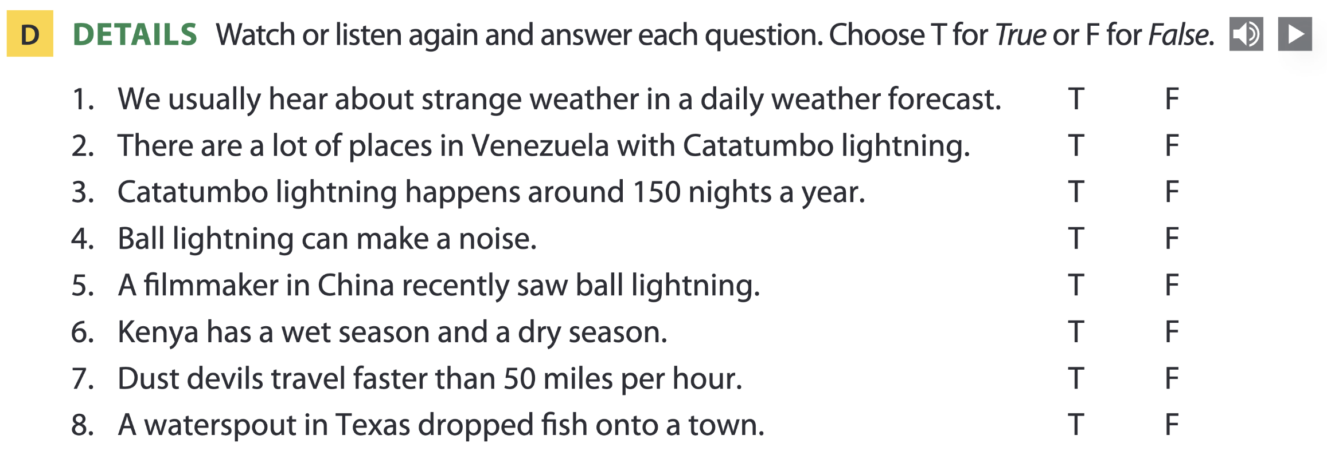
Page 67

Slide 20
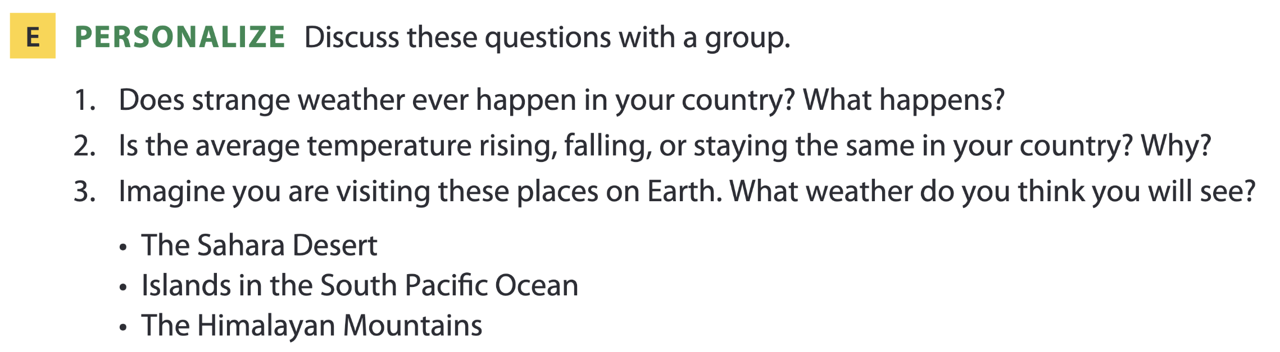
Page 67

Slide 21

03
Video watching

Slide 22
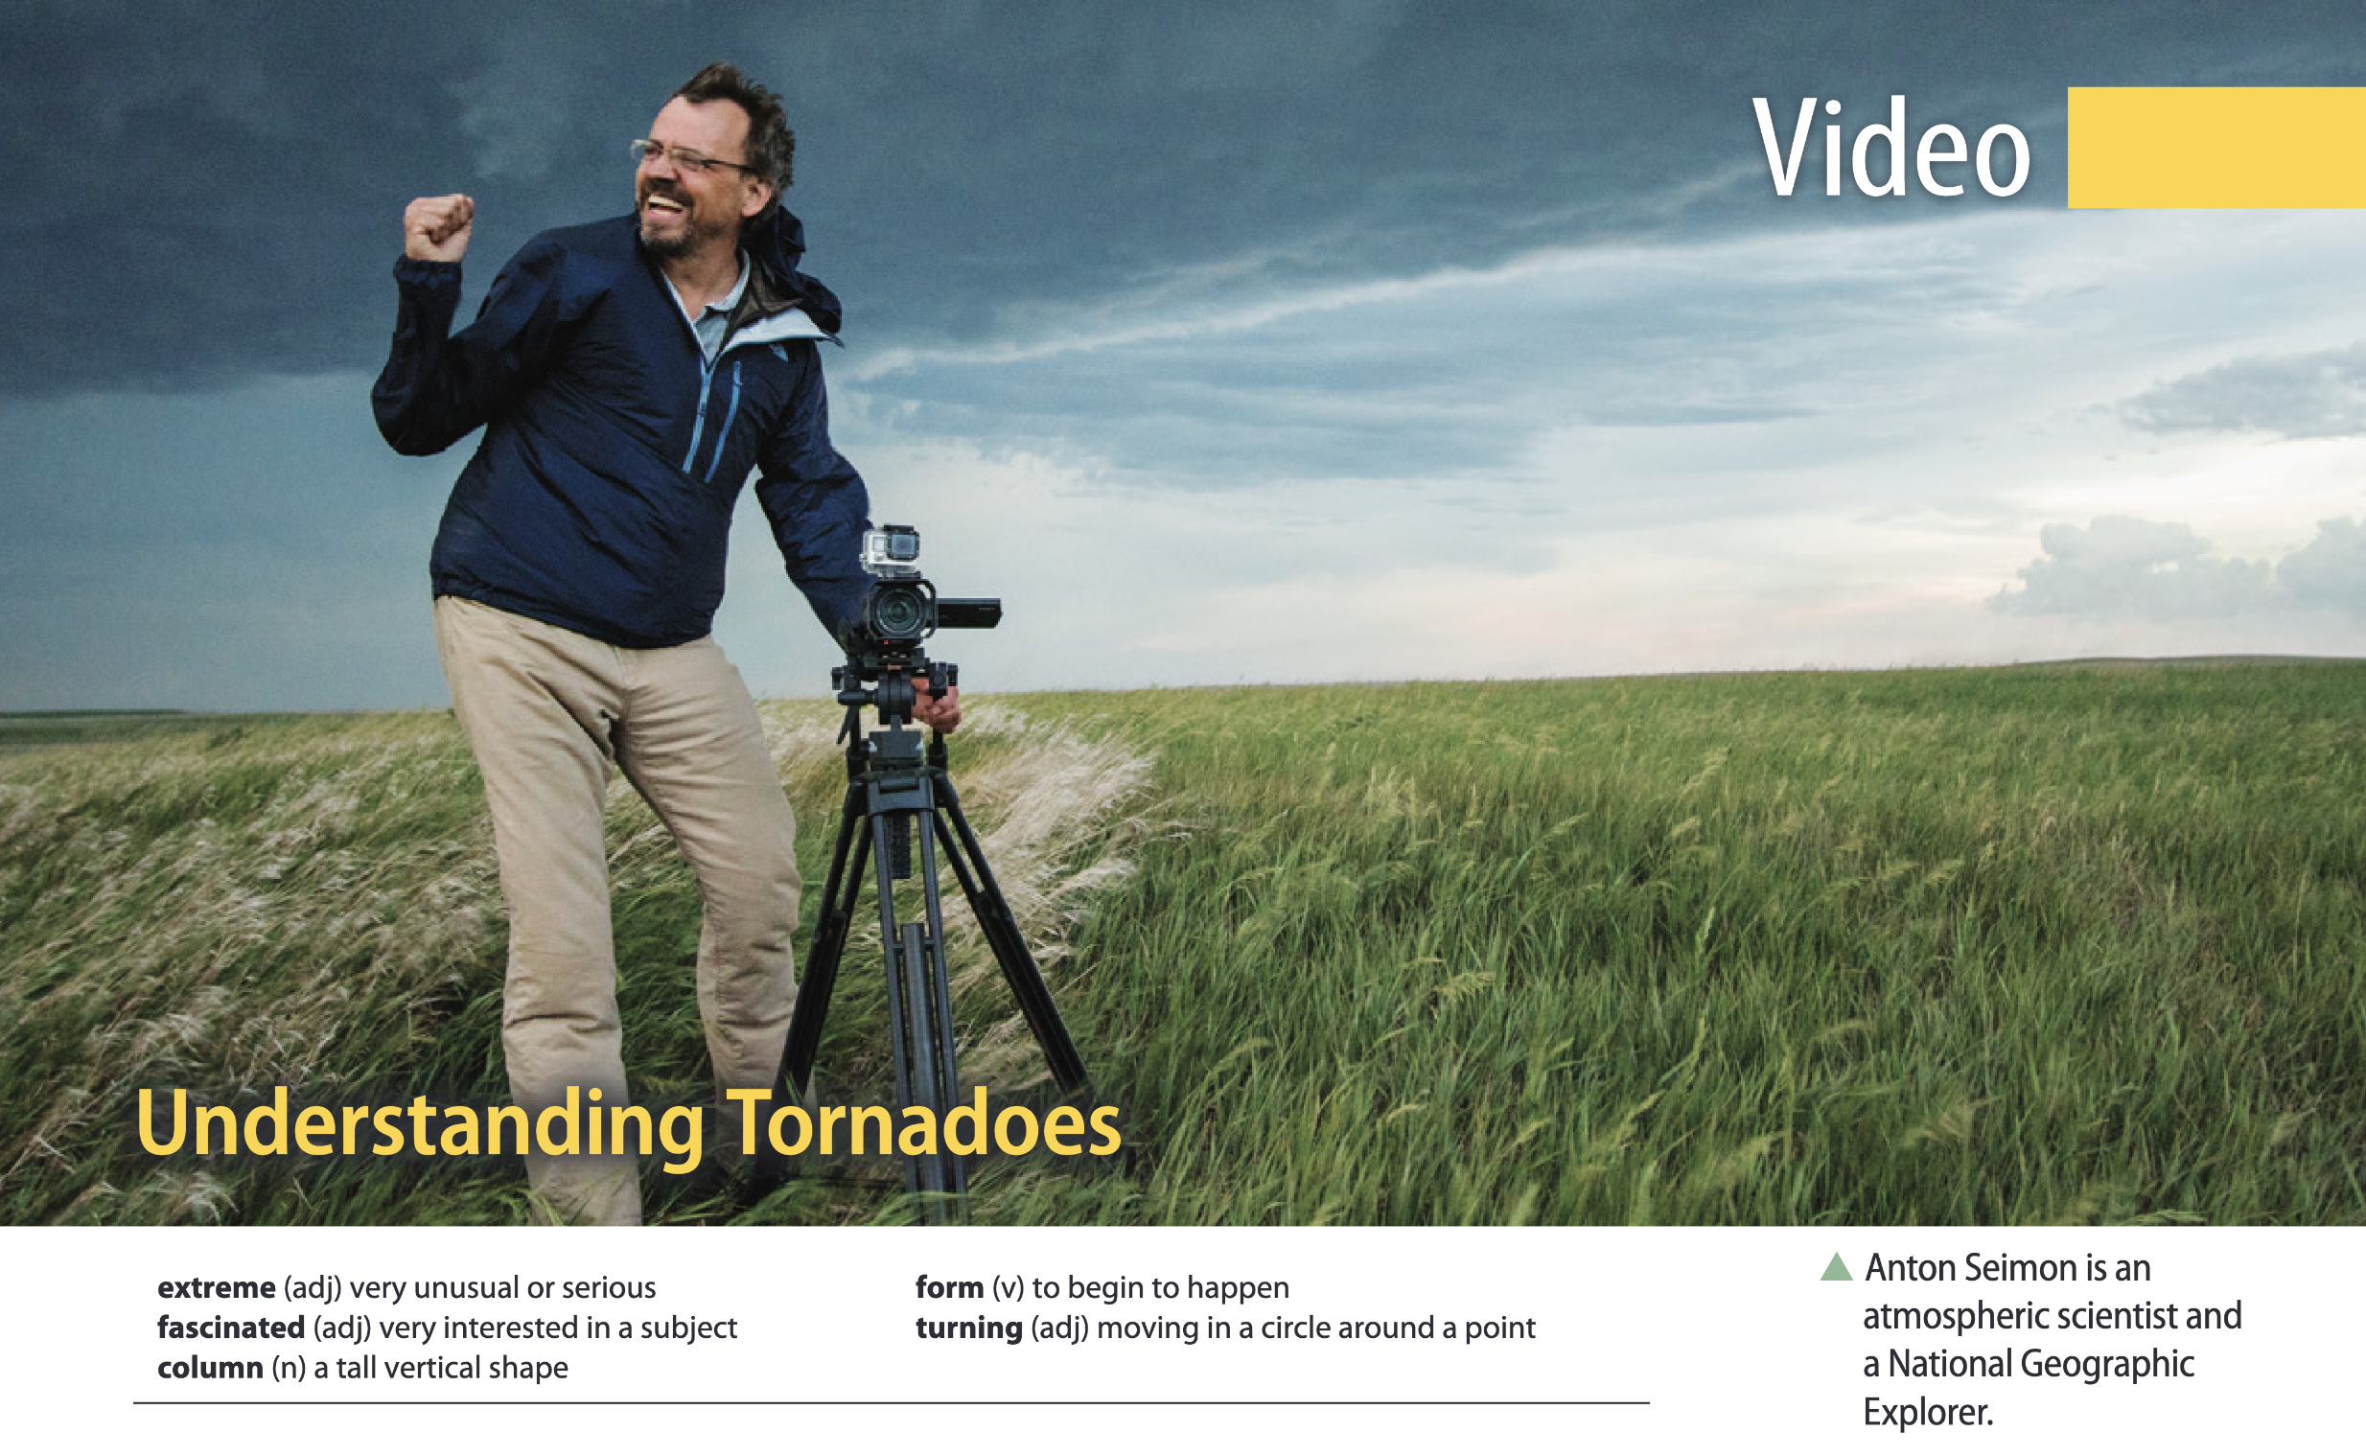
Page 71

Slide 23
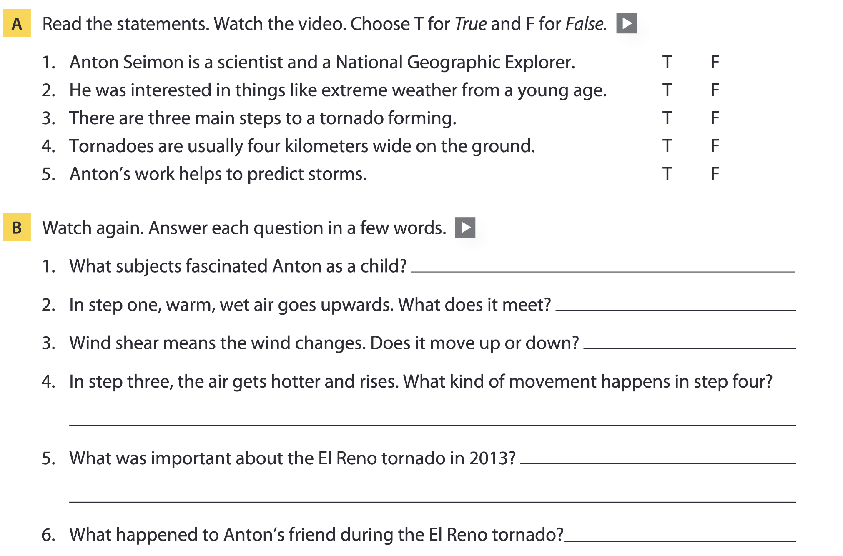
Page 71
mountaineering, storms, volcanoes
dry air
up
a turning movement
It was the biggest tornado in the world.
He died.

Slide 24
04
Vocabulary B

Slide 25
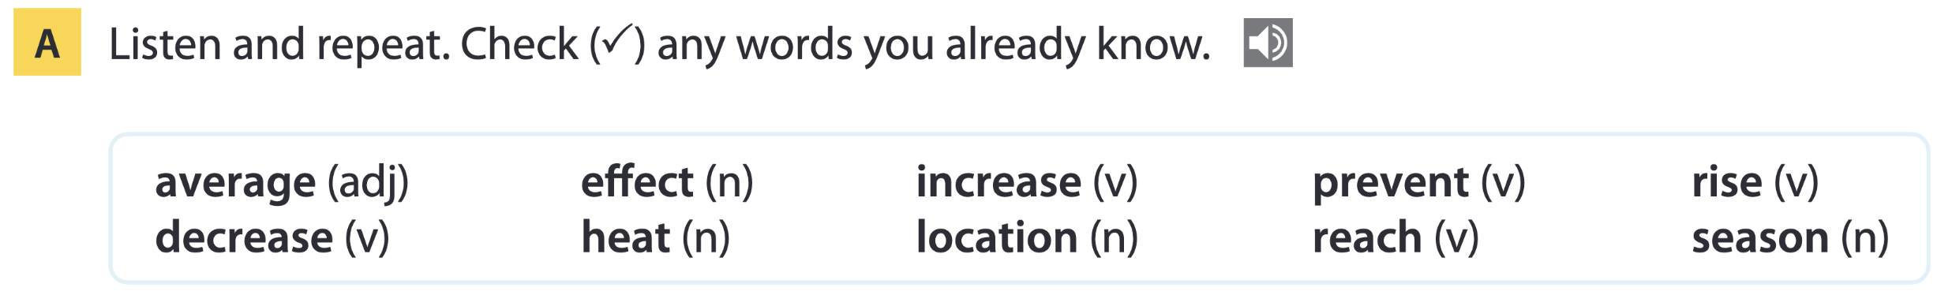
Page 72

Slide 26
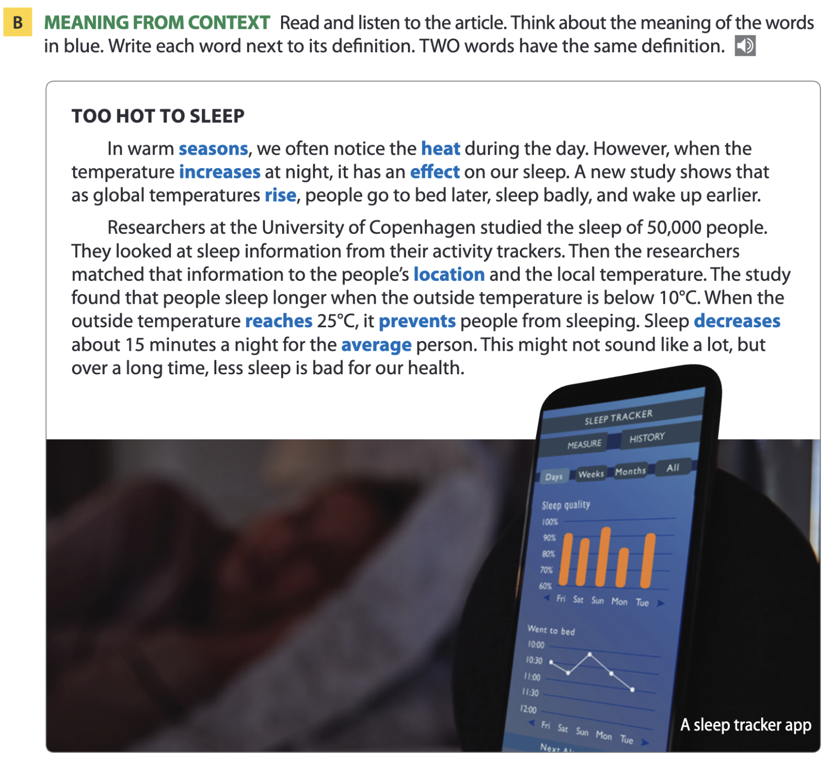
Page 72

Slide 27
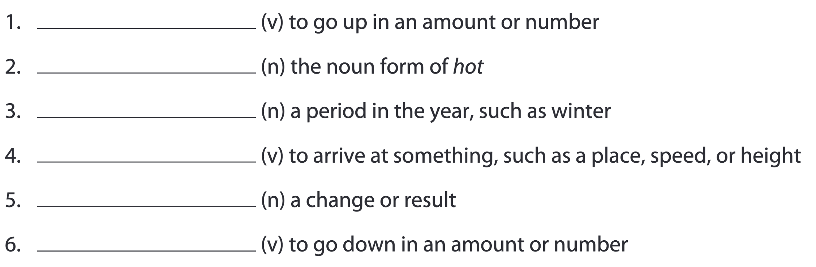
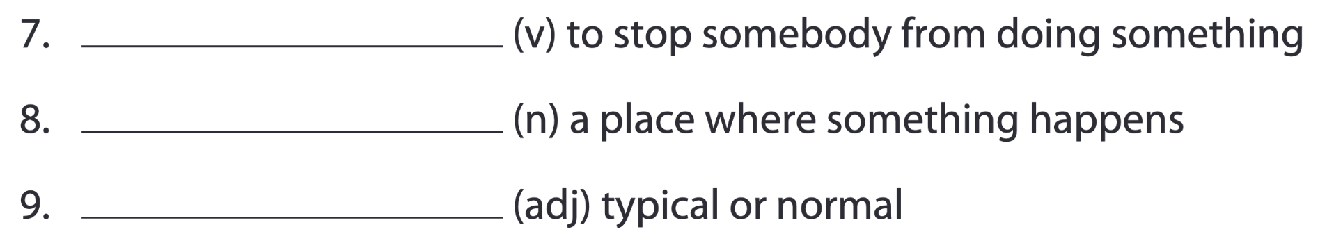
Pages 72-73
increase; rise
heat
season
reach
effect
decrease
prevent
location
average

Slide 28
Word list
average /ˈævərɪdʒ/ (adj): trung bình
decrease /dɪˈkriːs/ (v): giảm
effect /ɪˈfekt/ (n): tác động, hiệu ứng
heat /hiːt/ (n): sức nóng, nhiệt
increase /ɪnˈkriːs/ (v): tăng
location /ləʊˈkeɪʃən/ (n): vị trí, địa điểm
prevent /prɪˈvent/ (v): ngăn ngừa
reach /riːtʃ/ (v): đạt tới, chạm tới
rise /raɪz/ (v): tăng lên, dâng lên
season /ˈsiːzn/ (n): mùa

Slide 29
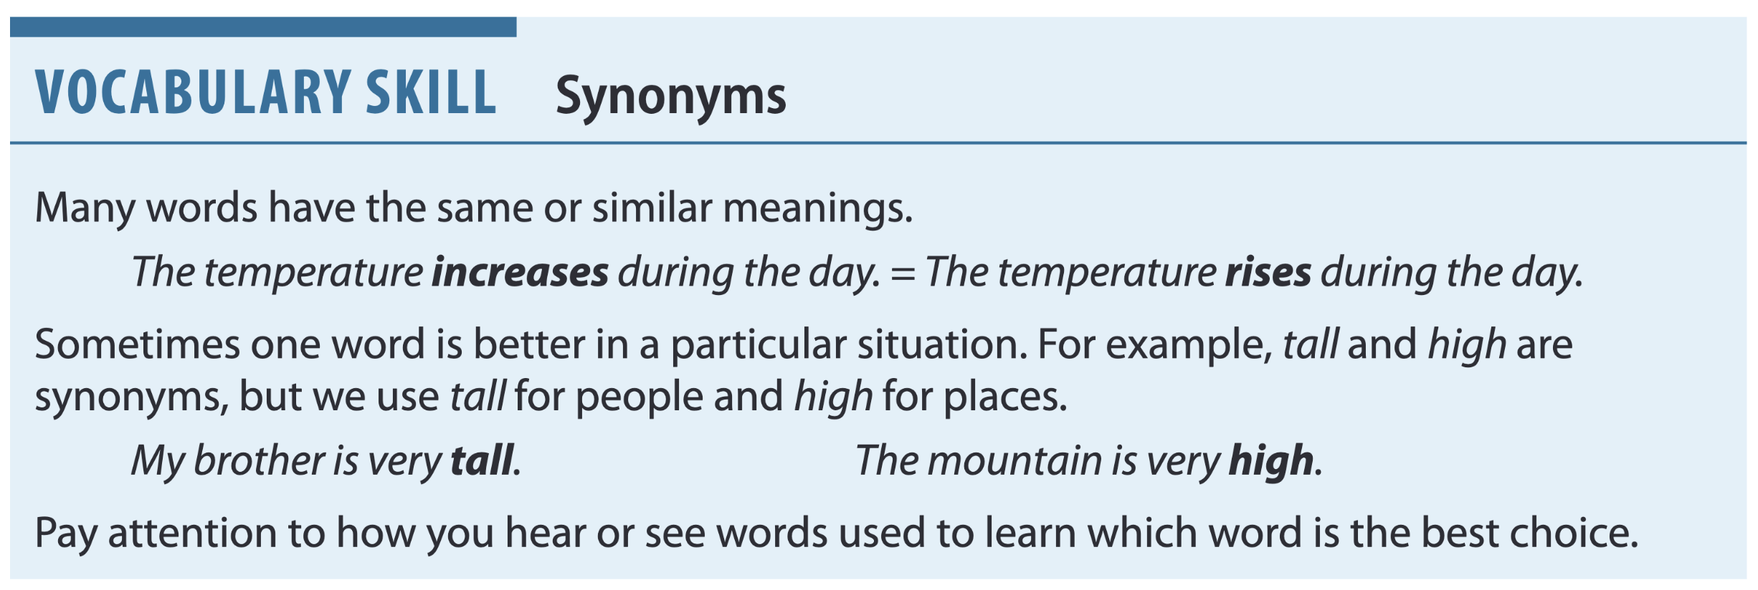
Page 73

Slide 30
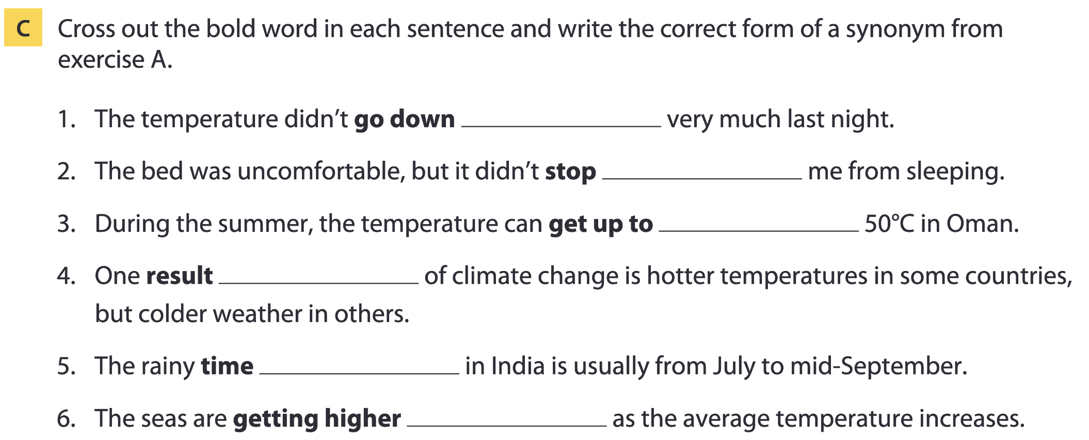
Page 73
decrease
prevent
reach
effect
season
rising

Slide 31
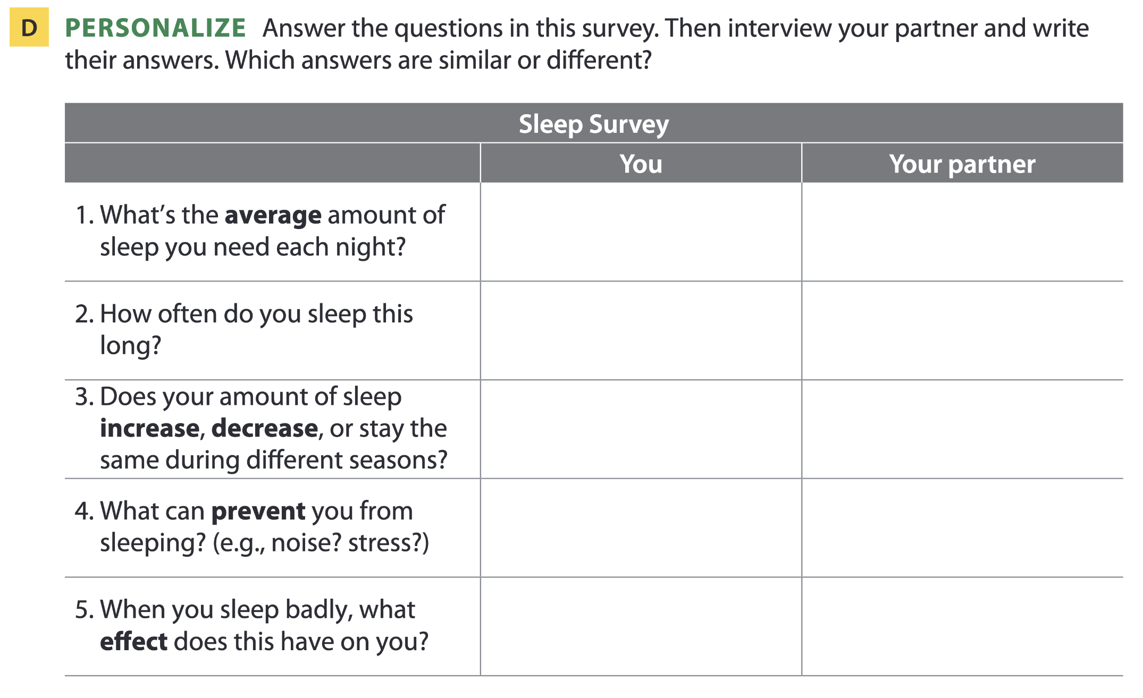
Page 73

Slide 32
05
Listening B

Slide 33
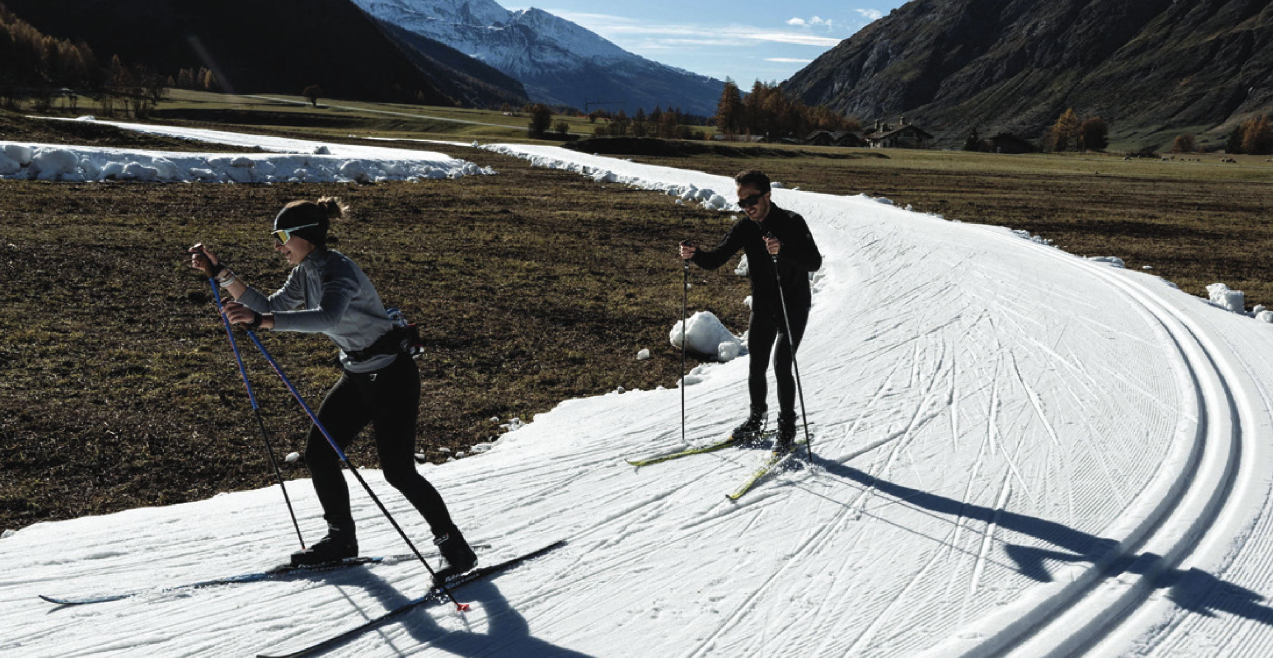
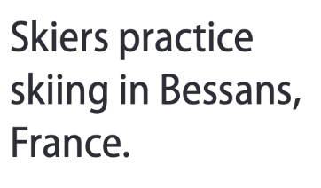
The future of sports

Slide 34
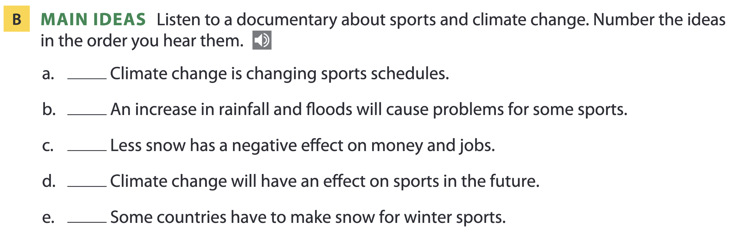
Page 74
2
5
4
1
3

Slide 35
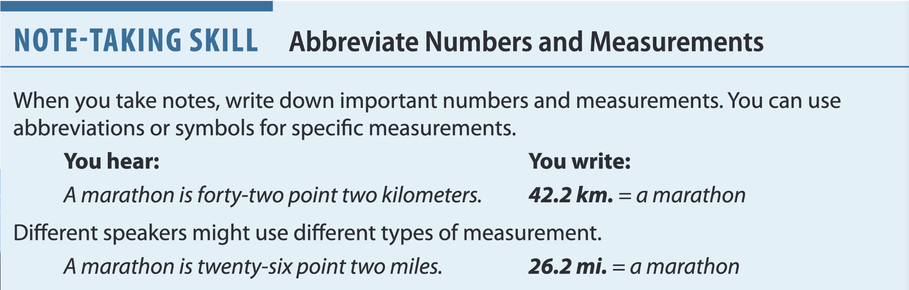
Page 74

Slide 36
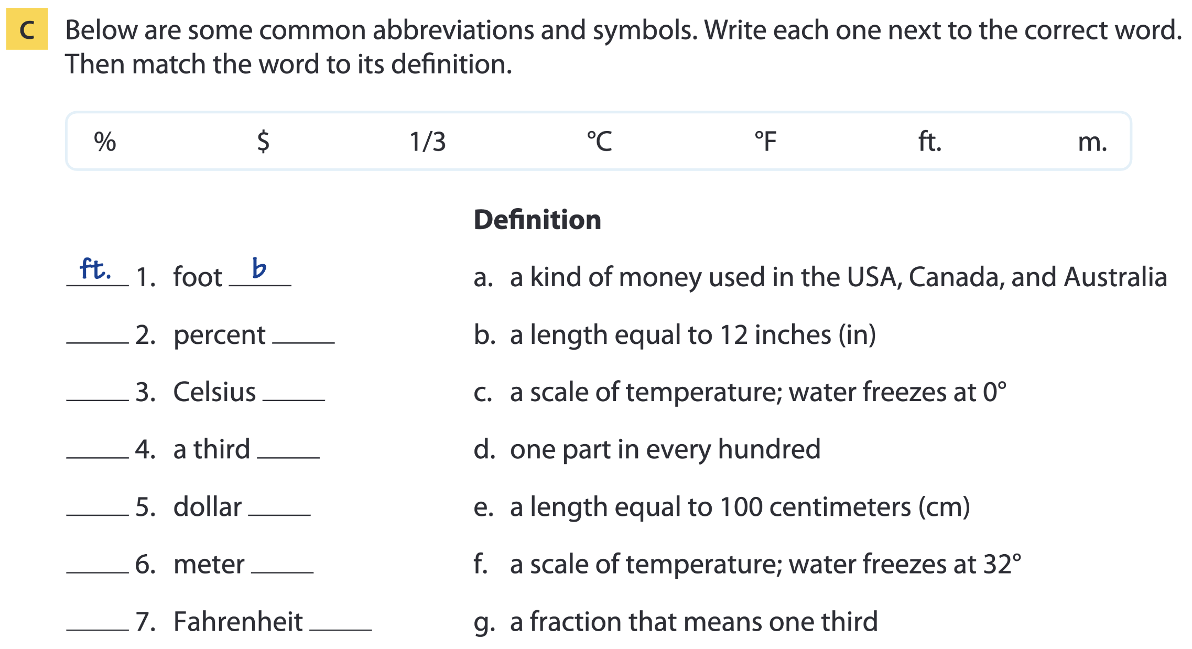
Page 75
% d
°C c
1/3 g
$ a
m. e
°F f

Slide 37
OTHERS:
kg =
lb =
oz =
sec =
min =
hr =
kilogram(s)
pound(s)
ounce(s)
second(s)
minute(s)
hour(s)
mph =
kph =
gal =
mL =
L. =
miles per hour
kilometers per hour
gallon(s)
milliliter(s)
liter(s)

Slide 38
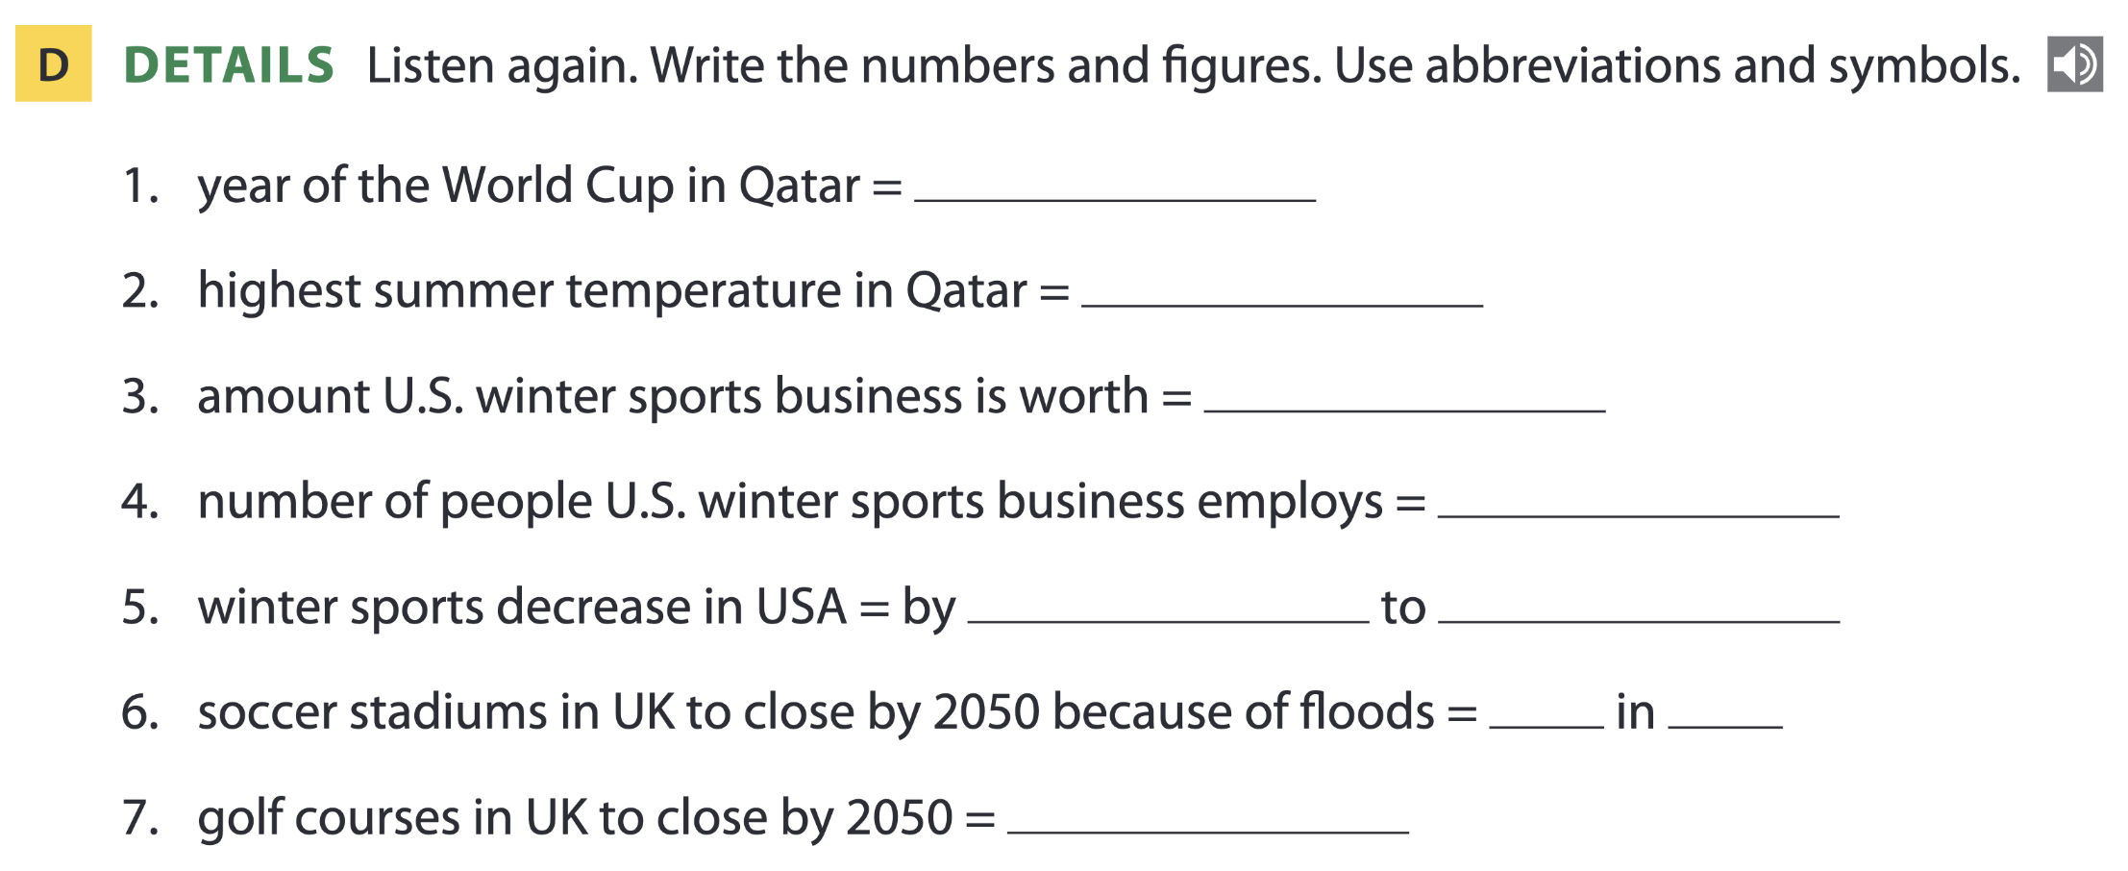
Page 75
2022
50°C
$60 bil.
900,000
25% 100%
1 4
1/3

Slide 39
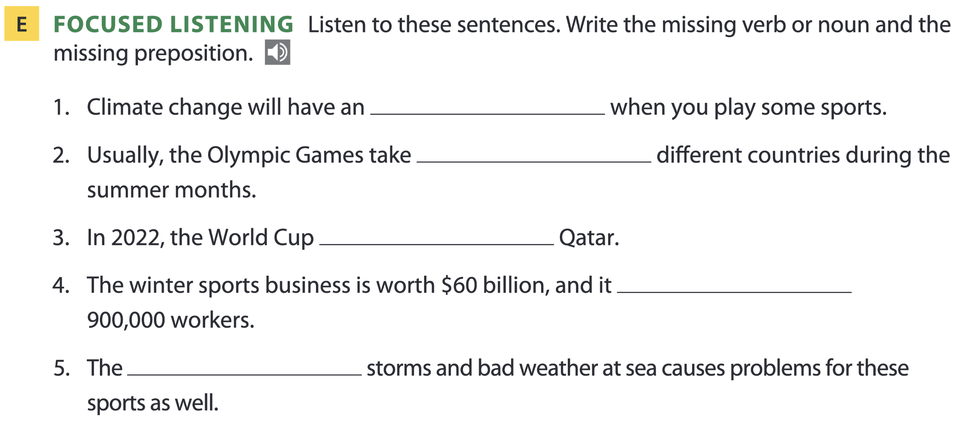
Page 75
effect on
place in
was in
has around
increase in

Slide 40
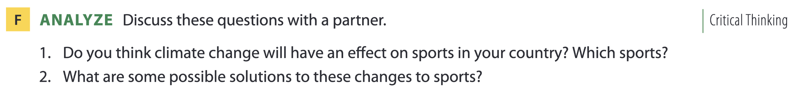
Page 75

Slide 41
THANKS FOR YOUR ATTENTION!

